Slide 1

Best Buy Project Week: Sales Forecast for Slow-selling SKUs
Team: Random Sampler
Ashish Dhiman, Anshit Verma, Yibei Hu

Slide 2


Executive Summury
Objective
7-day sales forecast for 539 slow-moving items based on their 4 year performance and other exogenous factors.
Ensemble Approach
Modelling
Holt-Winters/
Prophet
STL/MSTL
HMM
Result
RMSE: 2.21
Run Time: ~ 4H
Summary
Model
Results
Business Impact
EDA
Benchmark

Slide 3
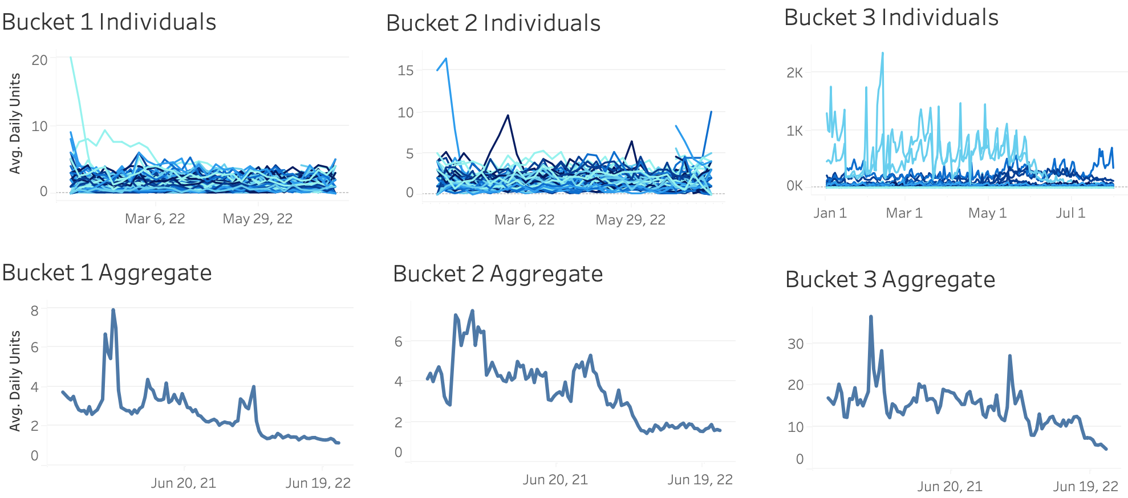
Exploratary Data Analysis: Patterns & Classifications
Bucket 1: low var & low mean
Bucket 2: mid var & low mean
Bucket 3: high var & high mean
EDA
Business Impact
Summary
Benchmark
Model
Results

Slide 4
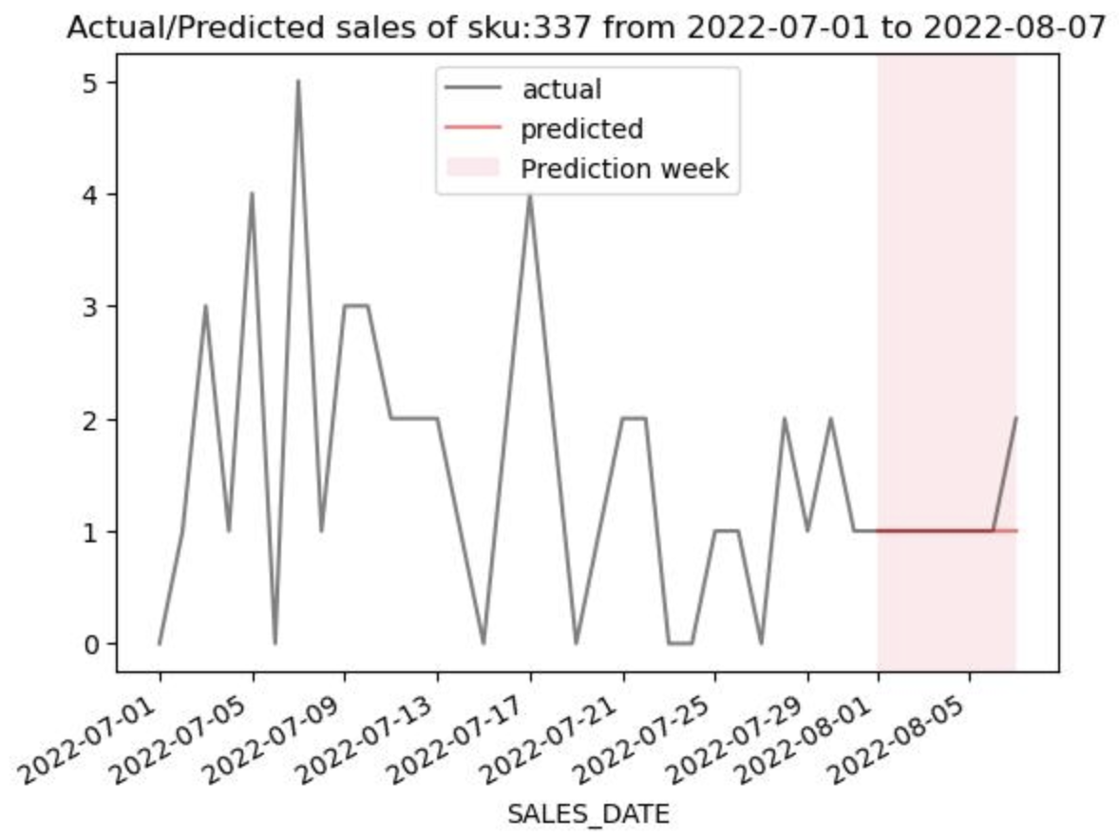
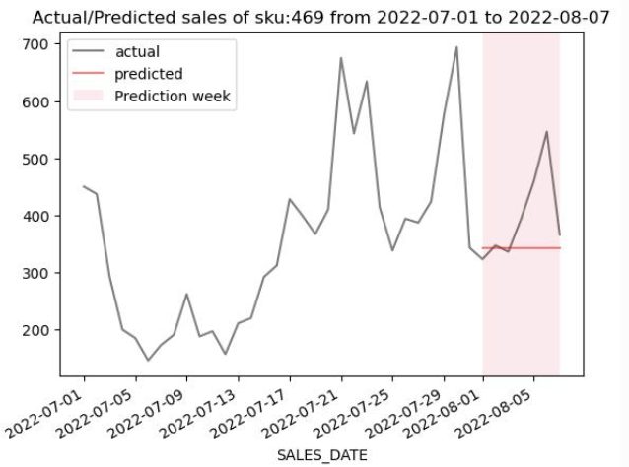
Benchmark: The Null Model
Null Good
Null Bad
Construction:
RMSE:
Performance:
Naively predicting with last training day’s value.
5.29
Good in low volatility SKUs
Benchmark
Business Impact
Summary
EDA
Model
Results

Slide 5
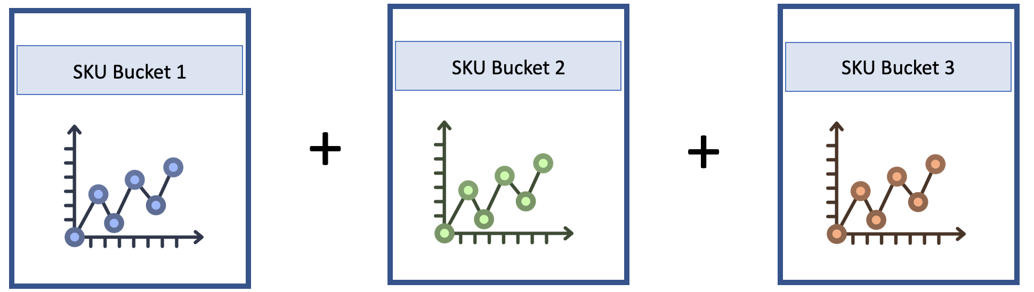
Modeling Approach: Overview of the Ensemble Approach
Ensemble Approach
Model 1: Holt-Winters / Prophet
Model 2:
STL / MSTL
Model 3:
HMM
Model
Business Impact
Summary
EDA
Benchmark
Results

Slide 6
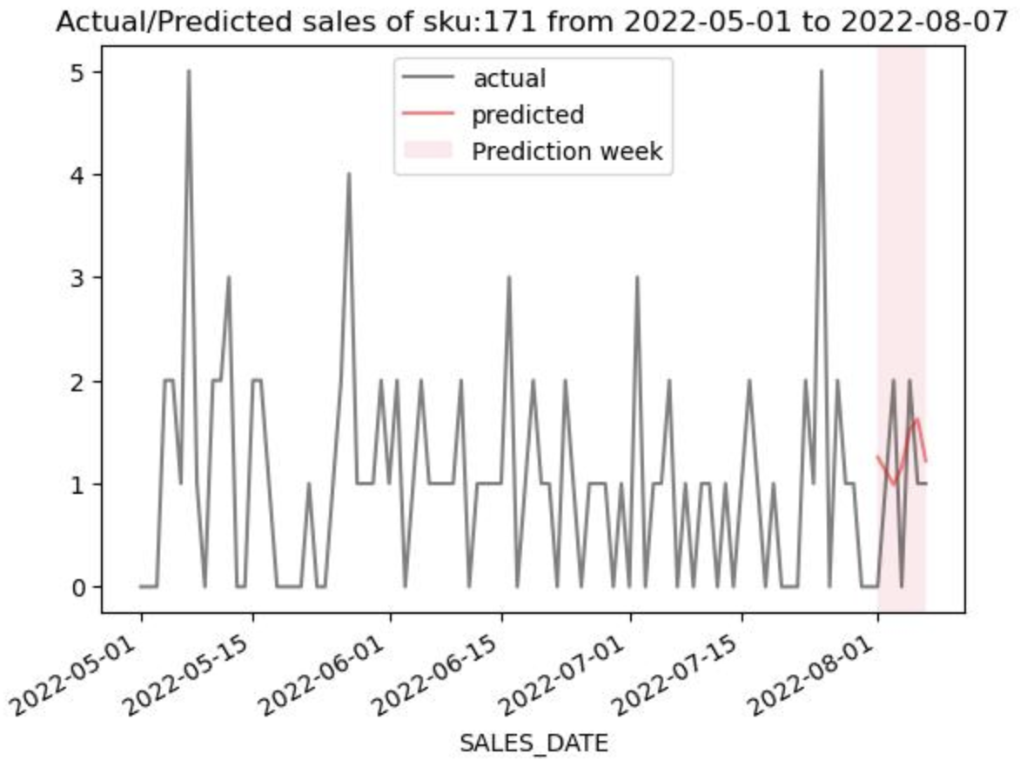
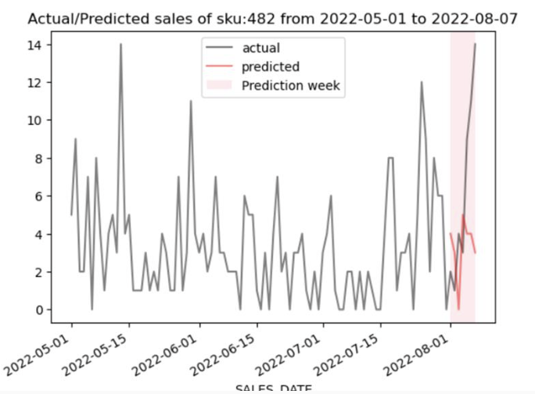
Model 1: Basic Models (Holt-Winters & Prophet)
Holt-Winter Good
Holt-Winters Bad
Bucket Size:
RMSE:
Runtime:
311 SKUs
4.83
~2.7s / SKUs
9.6% improvement over null model
Model
Business Impact
Summary
EDA
Benchmark
Results

Slide 7
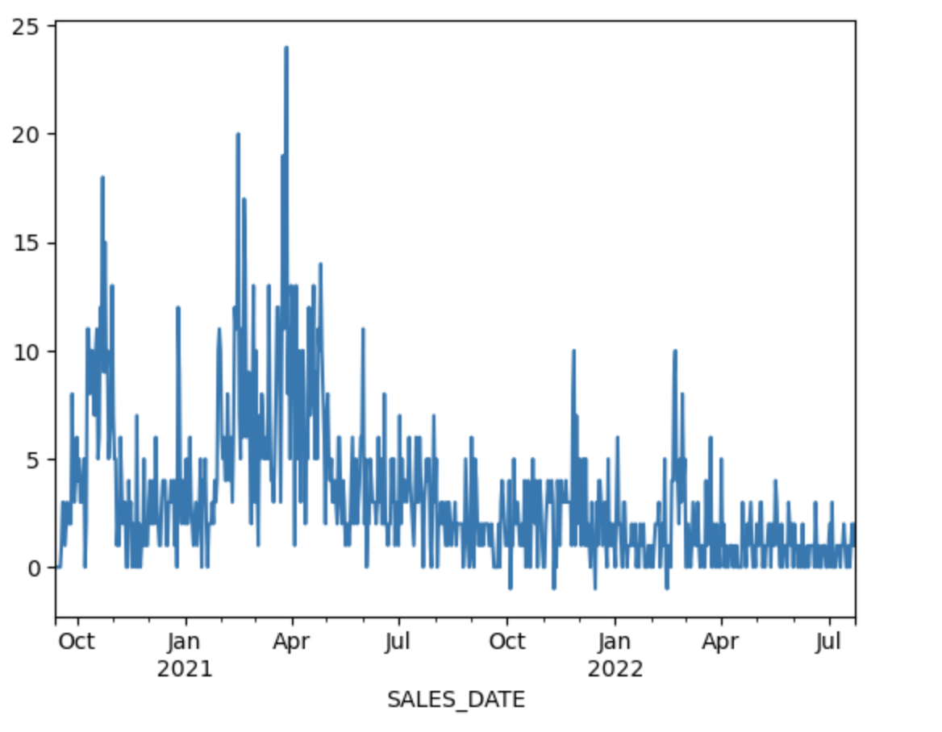
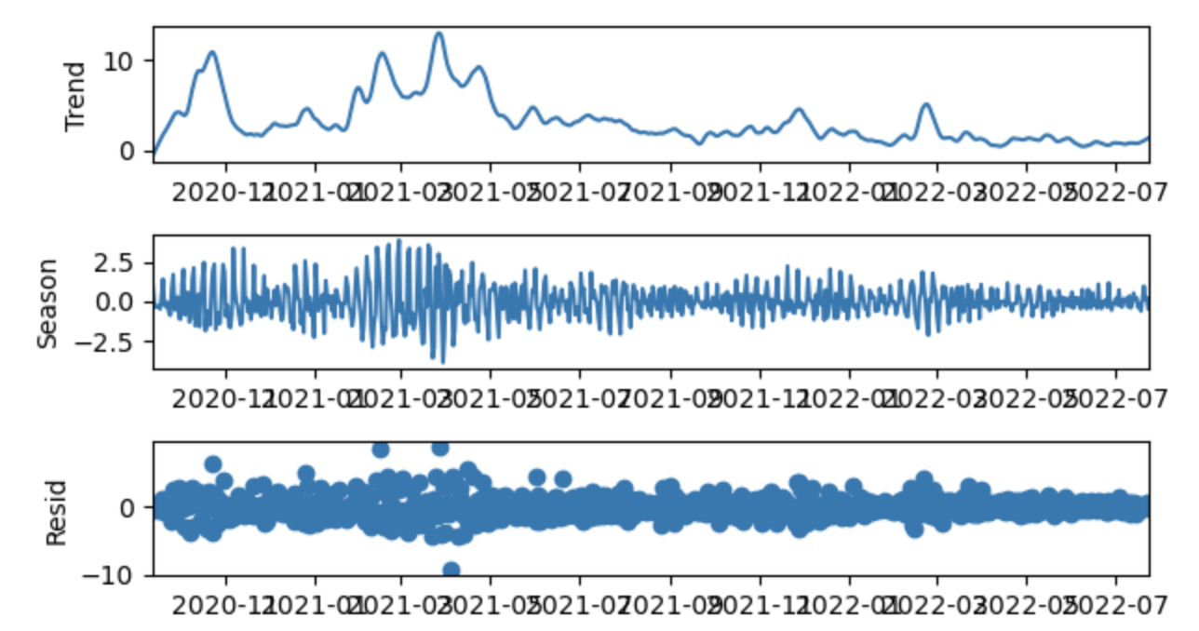
Model 2: ML Models over STL/MSTL decomposition (1/2)
Auto Regression
+
Xgboost
+
Ridge Regress.
Prediction
Model 2 expands on the philosophy of Prophet by applying STL decompostion to SKUs and using models to indviduall predict those. Holiday variables created from prophet also feed in as exogeneous variables.
Model
Business Impact
Summary
EDA
Benchmark
Results

Slide 8
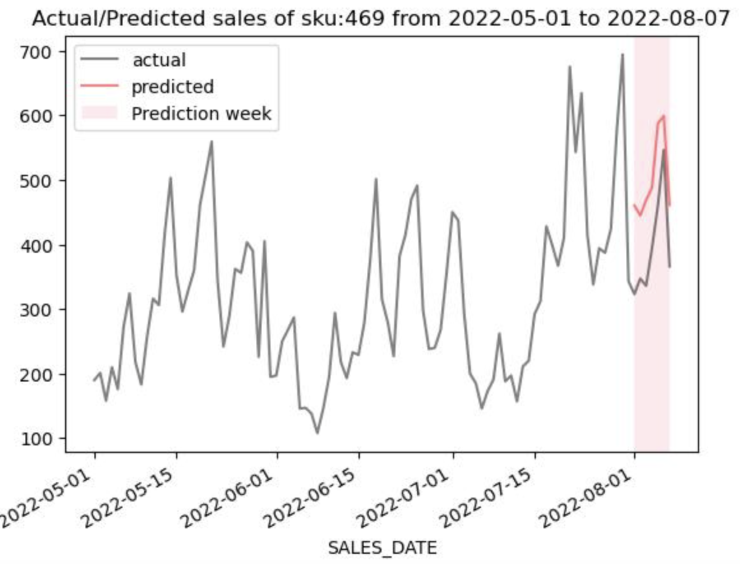
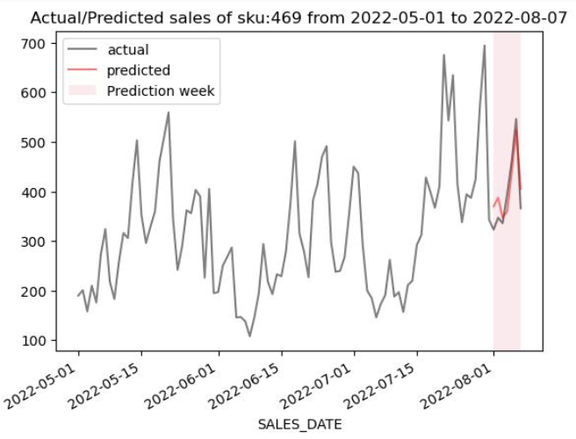
Model 2: ML Models over STL/MSTL decomposition (2/2)
Prophet
STL
Bucket Size:
RMSE:
Runtime:
80 SKUs
3.23
~70s / SKUs
39% improvement over null model
* Includes Prophet,
Training + Scoring
Model
Business Impact
Summary
EDA
Benchmark
Results

Slide 9
Model 3: Probabilistic Models | HMM (1/2)
Hidden Markov Model
Forecast:
Latent
Variables
X₁
X₂
X_{t}
Observed variable space
Y₁₁
Y₂₁
Y_{t1}
HMM Model
Observed
variables
Y₁₂
Y₂₂
Y_{t2}
Y₁₃
Y₂₃
Y_{t3}
Most Probable outcome {Y_{t+1,}}
Specific SKUs are modelled as Hidden Markov Chain, with observed variables constrcuted out of lagged daily units. Forecasting is implemented as a search through probable observation variables to find the most probable observation vector.
Model
Business Impact
Summary
EDA
Benchmark
Results

Slide 10
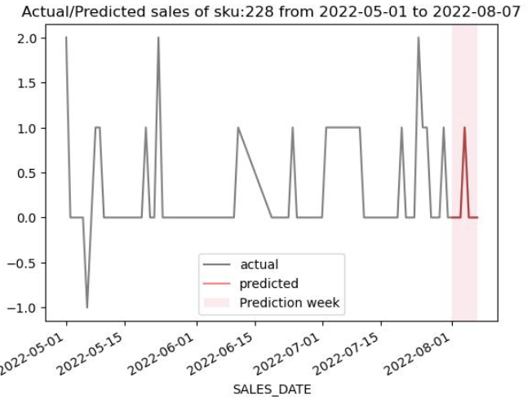
Model 3: Probabilistic Models | HMM (2/2)
HMM Good
HMM Bad
Bucket Size:
RMSE:
Runtime:
109 SKUs
2.21
~80s / SKUs
58.23% improvement over null model
Training + Scoring
Model
Business Impact
Summary
EDA
Benchmark
Results

Slide 11
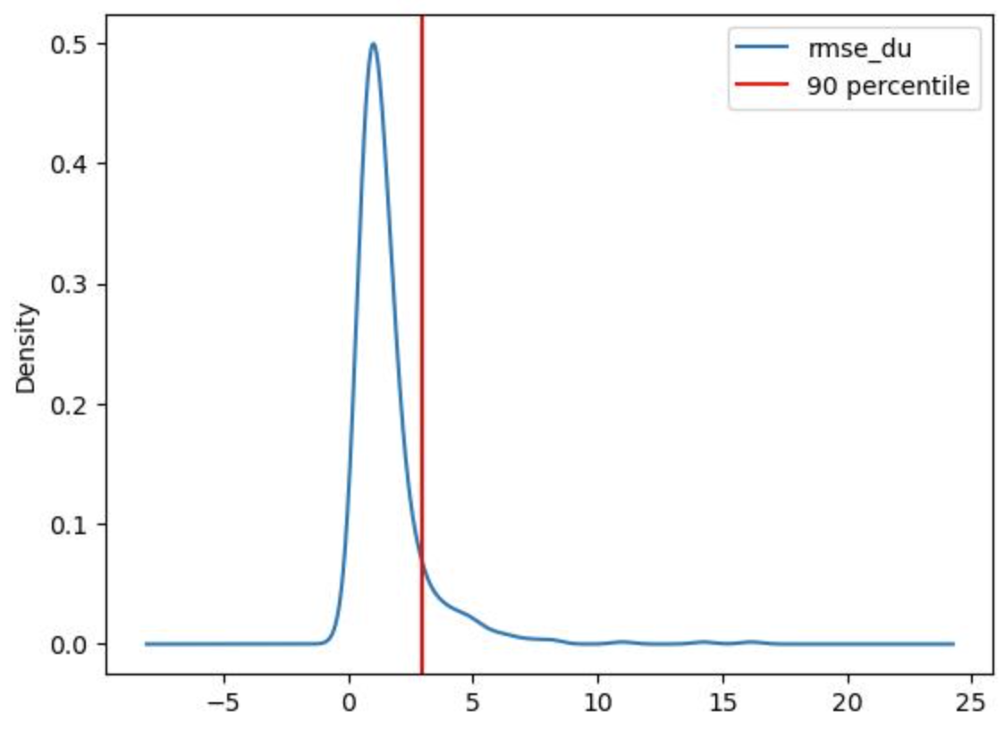
Aggregated Result
RMSE
RMSE Dist. for single SKUs
2.21
58.23% improvement over null model.
9.6% -Prophet / Holt-Winters
29.4% - STL/MSTL
28.8% - HMM
Run Time
~4H
Training + Scoring
The 90% percentile of single SKU RSME is 2.93. The RMSE is right skewed, which distorted the prediction
Summary
Result
Business Impact
EDA
Benchmark
Model

Slide 12



Business Impact and Future Outlook
Inventory
Distribution
Delivery
Better prediction would reduce the cost for inventary storage and purchase. Improve inventary turnover while lower storage cost.
More accurate in time needs prediction would lead to better supply chain decisions that increase batch delivery and lower deliver cost.
More precise prediction would assist customer to make in-time purchase, which would improve long-term customer loyalty.
Business Impact
Summary
EDA
Benchmark
Model
Results

Slide 13

RS
Thank You!
Ashish Dhiman: https://www.linkedin.com/in/ashish1610dhiman/
Anshit Verma: https://www.linkedin.com/in/anshitverma/
Yibei Hu: https://www.linkedin.com/in/olivia-hu9908/

Slide 14
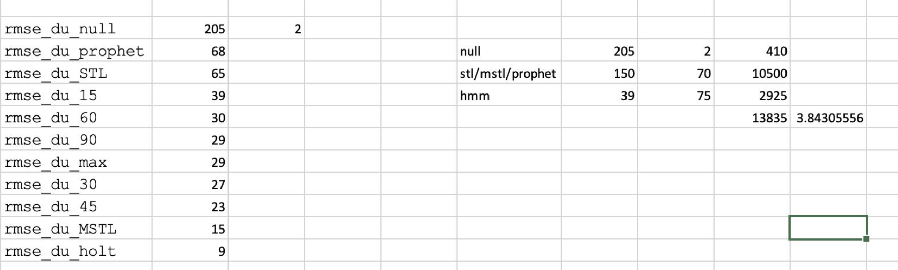
Appendix 1: Run Time Calculation
Appendix

Slide 15
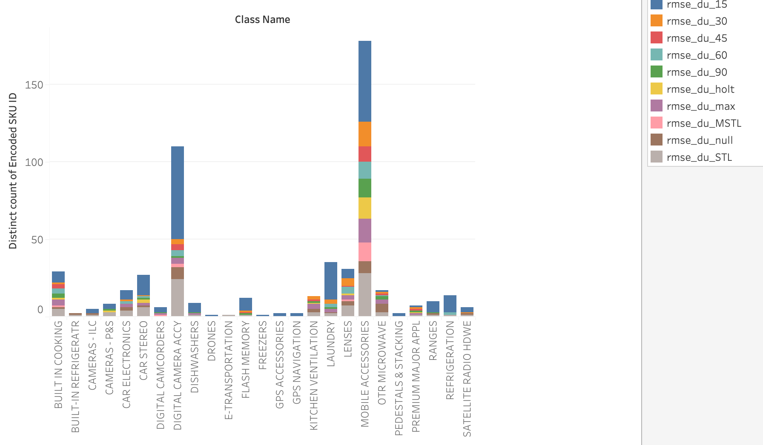
Appendix 2: Class/ model mapping
Appendix

Slide 16
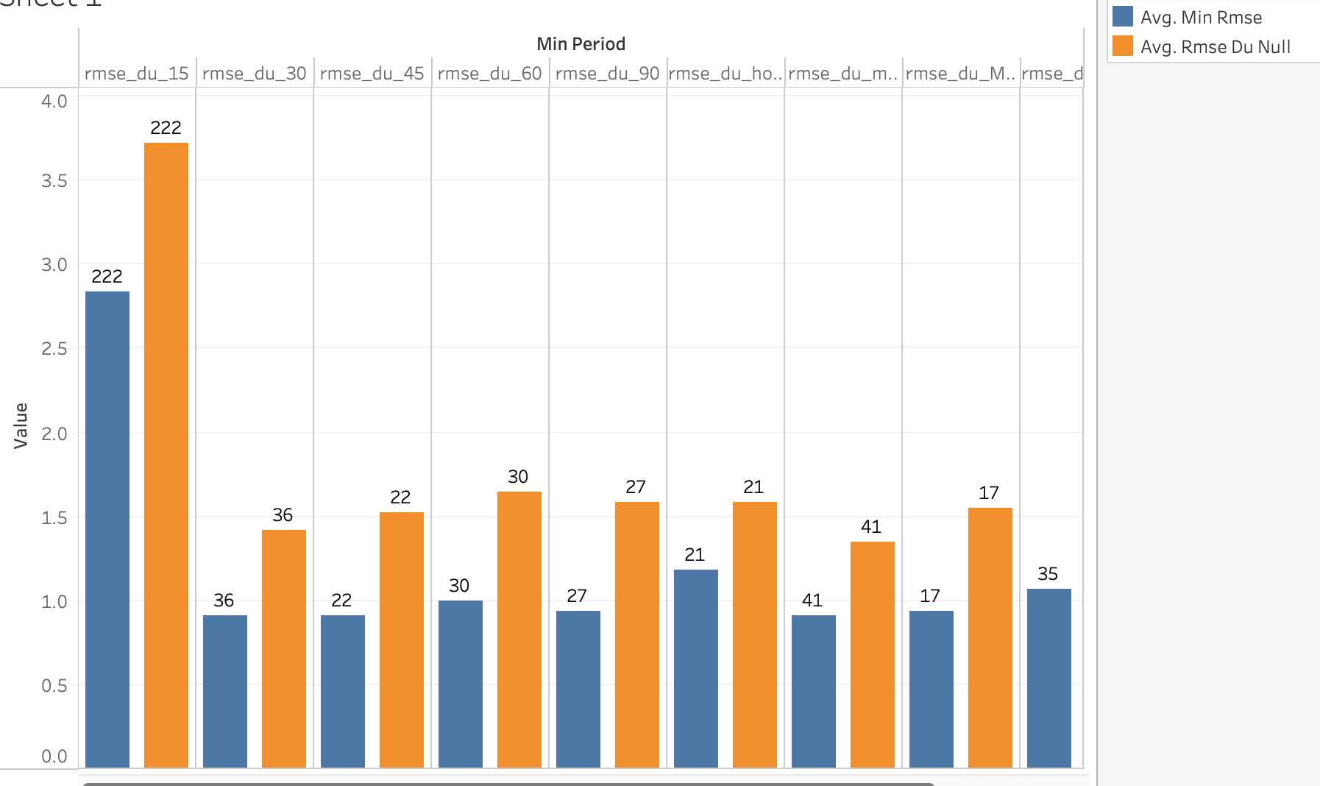
Appendix 3: Each Model’s effect in average RMSE reduction(Train data)
Appendix

